Slide 1
Deep Learning

Slide 2
Machine Learning vs Deep Learning
Dimension / Feature | Classical Machine Learning (ML) | Deep Learning (DL)
Primary Data Type | Structured / Tabular data (CSVs, SQL tables, Excel spreadsheets) | Unstructured data (Images, Video, Audio, Text, Speech)
Feature Extraction | Manual: Features are hand-crafted by domain experts (e.g., SIFT, HOG, engineered variables) | Automatic: Features are learned hierarchically directly from raw data
Data Volume Scaling | Works well on small/medium datasets; performance plateaus on massive data | Performs poorly on small datasets; performance scales continuously with massive data
Hardware Requirements | Standard CPUs | High-performance parallel hardware (GPUs / TPUs)
Problem-Solving Approach | Modular / Decomposed: Break the problem into pipeline steps and combine outputs | End-to-End: Input raw data directly into the network to get the final prediction
Model Interpretability | High: Easy to inspect decision trees, feature weights, or feature importance | Low: "Black Box" nature with complex non-linear parameters
Training Time | Fast (seconds to minutes/hours) | Slow (hours to days/weeks depending on architecture)
Dominant Algorithms | Linear Regression, Logistic Regression, Decision Trees, Random Forests, XGBoost, SVMs | Convolutional Neural Networks (CNNs), Recurrent Neural Networks (RNNs), LSTMs, Transformers

Slide 3
Deep Learning
Data Growth (Unstructured Data, images….etc)
Hardware Advancement (GPU vs DPU)
Python
Cloud

Slide 4
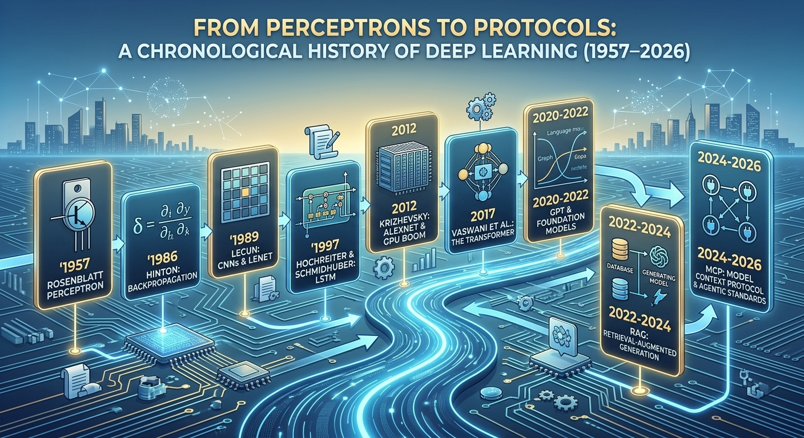
From Perceptron to Transformers

Slide 5
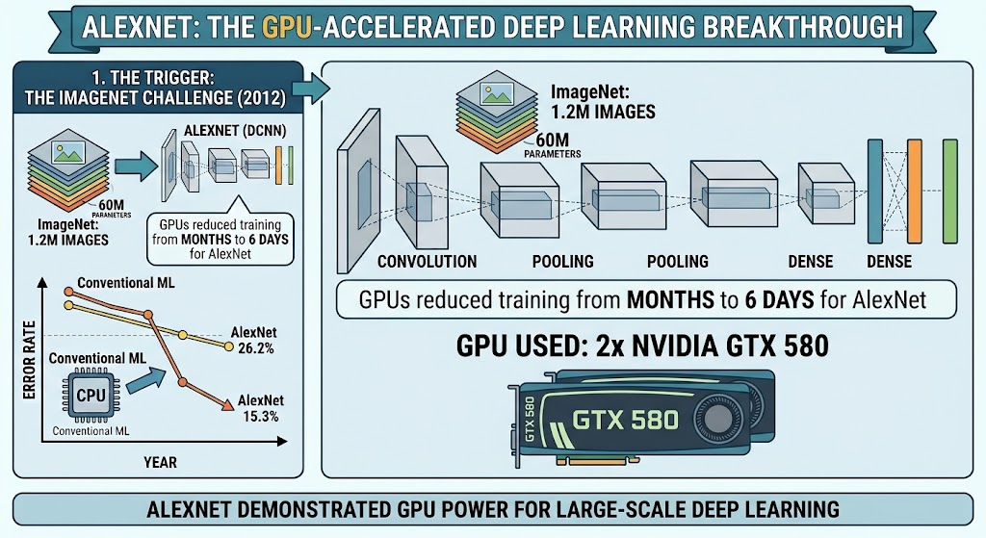
ALEXNET

Slide 6
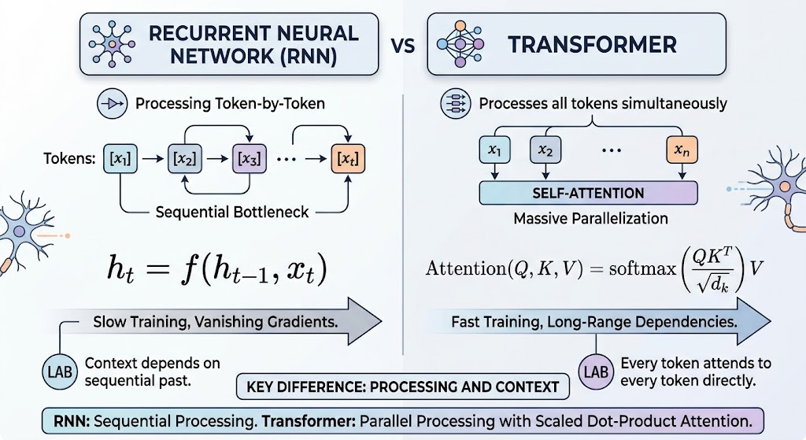
RNN vs Transformers

Slide 7
Deep Learning Applications
Application Area | Real-World Example | How Deep Learning (DL) Works
Chatbots & Customer Service | Automated retail order tracking and support assistants | Processes and understands natural language (NLP) to generate human-like text responses to customer questions automatically.
Self-Driving Vehicles | Autonomous cars detecting road obstacles in real time | Uses Convolutional Neural Networks (CNNs) to analyze camera frames and detect pedestrians, lane markers, and traffic signals instantly.
Healthcare Diagnostics | Early tumor and disease detection from medical scans | Scans X-rays, MRIs, and CT scans using computer vision to spot micro-abnormalities faster and more accurately than manual inspection.
Financial Trend Forecasting | Market trend prediction and automated risk management | Analyzes high-frequency tick data, market indicators, and news sentiment (via LSTMs/Transformers) to detect non-linear financial patterns.
Personalized Recommendations | Movie and product suggestions (e.g., Netflix, Amazon) | Evaluates user interaction histories using collaborative filtering networks to predict and recommend items a user is most likely to prefer.
Architectural Design & Efficiency | Floor plan generation and structural performance optimization | Tests thousands of 3D layouts, window placements, and massing shapes in seconds to maximize natural sunlight, airflow, and structural integrity.
Scientific Discovery | Rapid drug discovery and novel material design | Filters massive chemical and molecular databases to predict which compound combinations will yield safe, effective medicines without years of manual lab testing.

Slide 8

Tools
TensorFlow is an open-source framework for machine learning and artificial intelligence developed by Google Brain. It provides tools to build, train and deploy models across different platforms, especially for deep learning tasks.

Slide 9

Tools
Keras is a deep learning API that simplifies the process of building deep neural networks. Initially it was developed as an independent library, Keras is now tightly integrated into TensorFlow as its official high-level API.

Slide 10
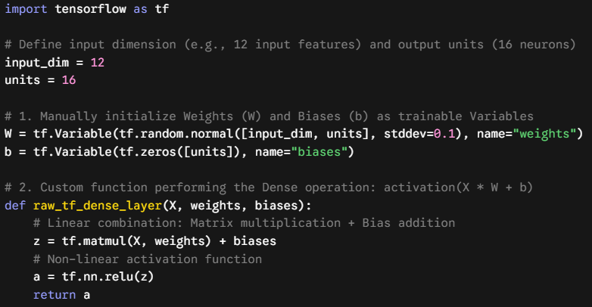
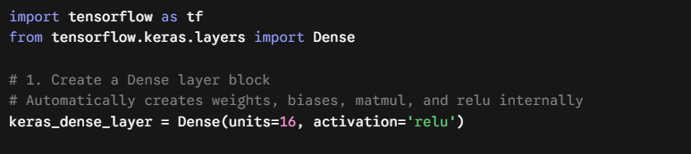

Slide 11
What is Perceptron (Input/Output Layer Neural Network)?
A Perceptron is the simplest form of a neural network that makes decisions by combining inputs with weights and applying an activation function. It is mainly used for binary classification problems. It forms the basic building block of many deep learning models.
Takes multiple inputs and assigns weights
Computes a weighted sum and applies a threshold
Outputs either 0 or 1 (binary outcome)
Forms the foundation of larger neural networks

Slide 12
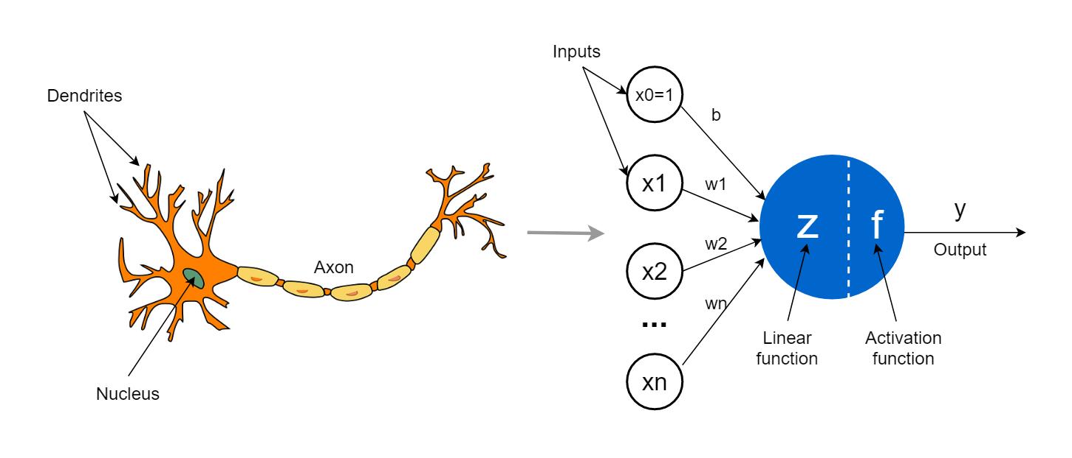
Frank Rosenblatt, 1957

Slide 13

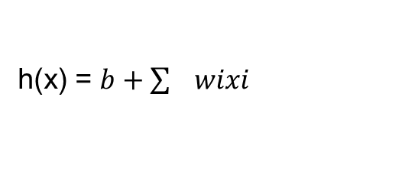
What is a neuron?
h(x) = b + w1x1+ w2x2+ w3x3
Age
Income
Education
Age
h(x) = 2 + 1.2x1+ 0.9x2- 0.83x3
w1
Education
w2
h(x) = $b+\sum{wixi}$
Z = 1 / (1+$e^{−y})$
Income
w3

Slide 14
What is Perceptron
Inputs : These are the features or measurable attributes of a data point that the perceptron uses to make a decision. Each input provides a signal that contributes to the final output.
Weights: Weights determine how strongly each input contributes to the prediction. A larger weight means the corresponding input has a higher impact.
Bias: The bias is a constant value added to the weighted sum to shift the decision boundary. If by mistake assigns weights to zero the training continue and we update weights later.

Slide 15
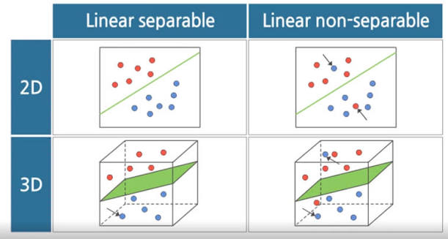
Advantages and Disadvantages of Perceptron

Slide 16
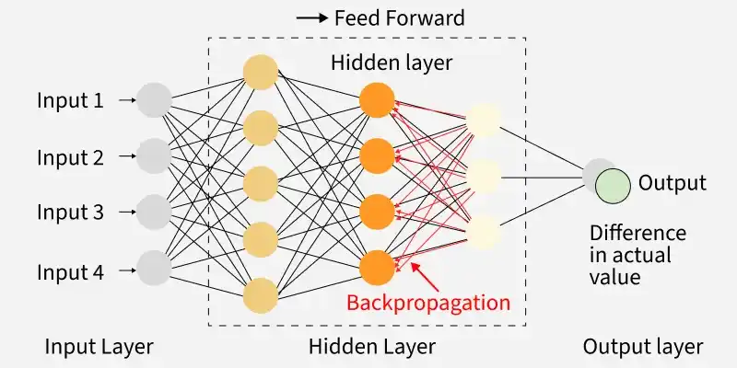
Multi Layered Neural Network
Artificial Neural Networks (ANNs) are the fundamental building blocks of modern deep learning systems. They consist of interconnected artificial neurons organized into layers that learn from training data to recognize patterns, make predictions and solve complex problems.

Slide 17
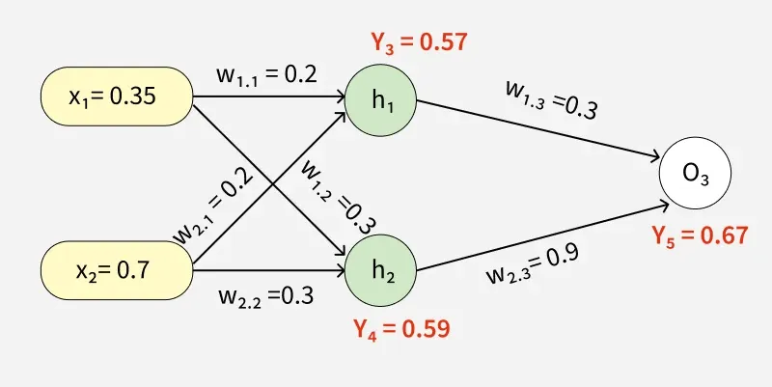
Forward propogation:
Forward propagation in neural networks is the process where input data flows through each layer of the model to generate an output. It’s the step-by-step computation that transforms raw inputs into predictions using weights, biases and activation functions. This operation forms the backbone of how neural networks learn patterns and make decisions.

Slide 18
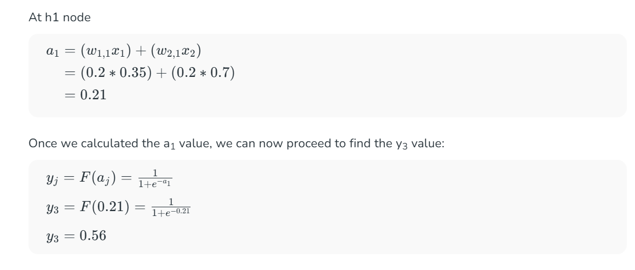
Forward Propogation
Initial Calculation

Slide 19
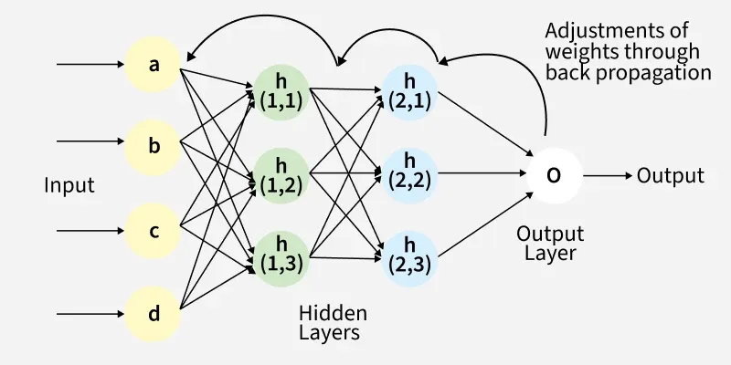
Backward Propogation
It works by propagating errors backward through the network, using the chain rule of calculus to compute gradients and then iteratively updating the weights and biases. Combined with optimization techniques like gradient descent, backpropagation enables the model to reduce loss across epochs and effectively learn complex patterns from data.
David E. Rumelhart, Geoffrey E. Hinton & Ronald J. Williams, 1986

Slide 20
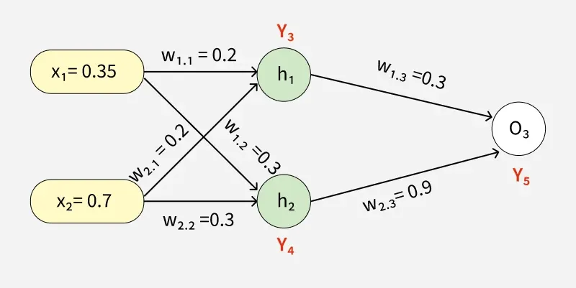
Example of Back Propagation in Machine Learning
The target output is 0.5.
Loss Function :
0.5-0.76 = -0.17

Slide 21
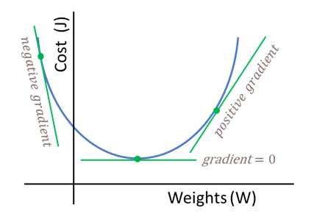
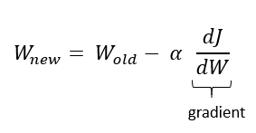
Backward Propogation: Weight Update

Slide 22
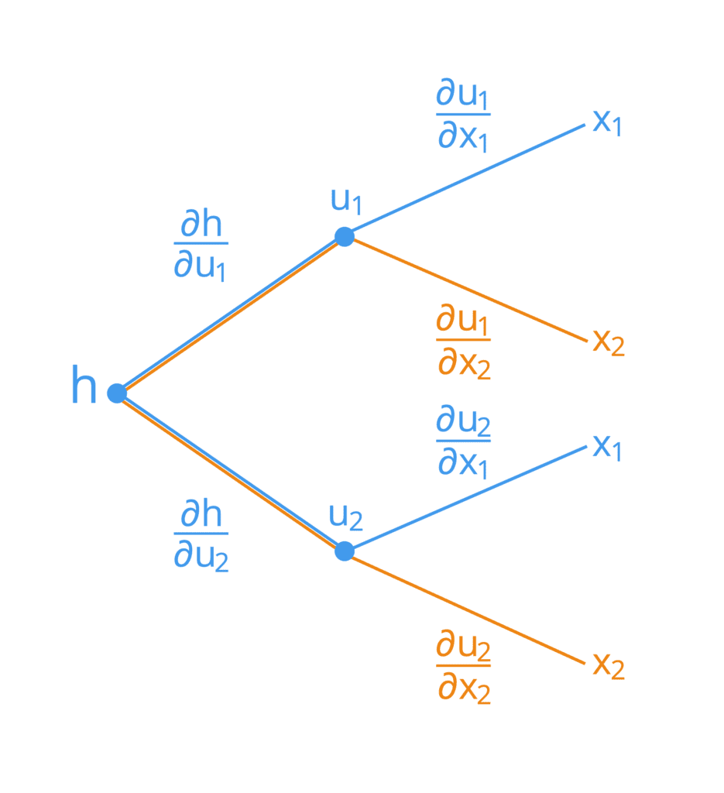
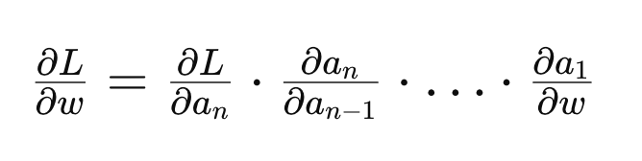
Backward Propogation: Chain rule of Derivatives

Slide 23
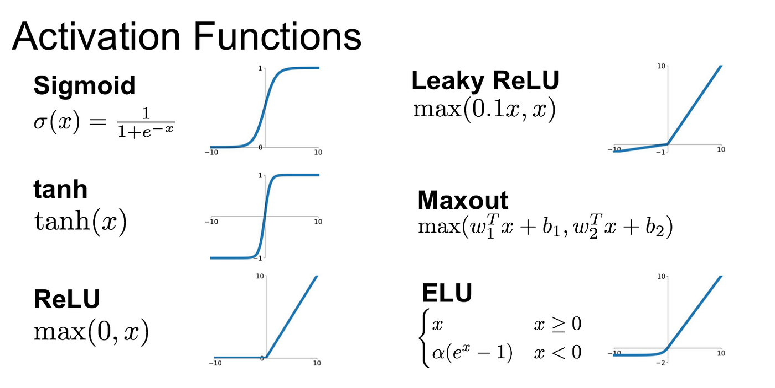
Activation Functions
An activation function is applied to the weighted sum of inputs before producing the final output of a neuron. It introduces non-linearity, allowing the network to learn complex patterns.

Slide 24
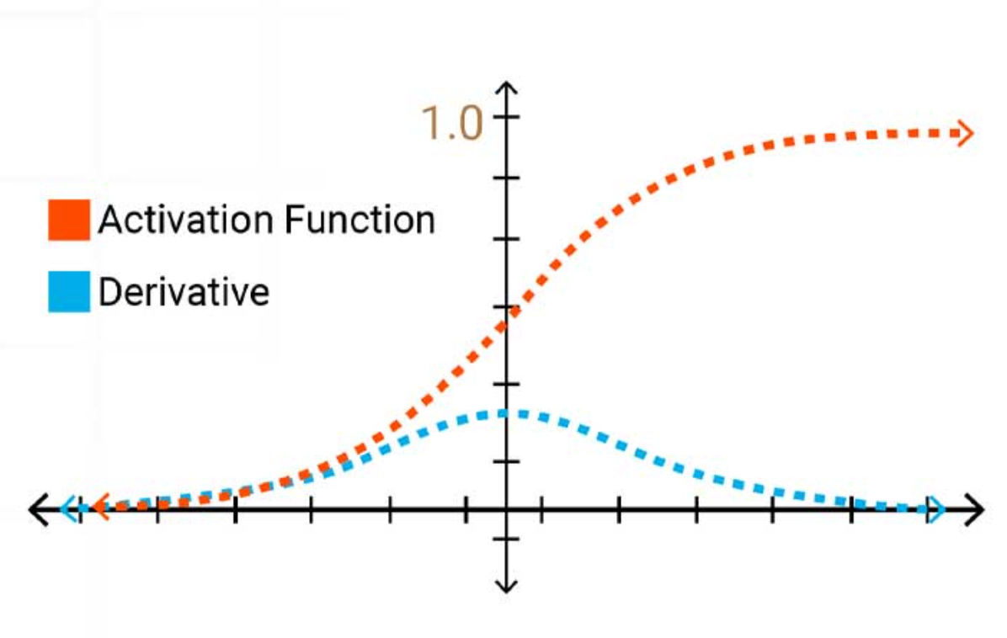
The vanishing gradient problem and Sigmoid
The vanishing gradient problem with the sigmoid function happens because its derivative has a maximum value of only 0.25.

Slide 25
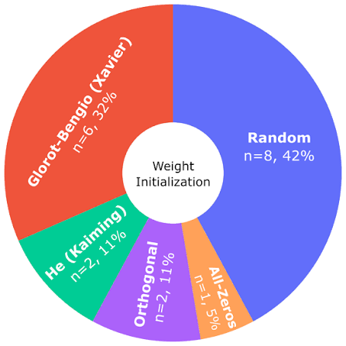
Weight Initialization Techniques for Deep Neural Networks
While building and training neural networks, it is crucial to initialize the weights appropriately to ensure a model with high accuracy. If the weights are not correctly initialized, it may give rise to the Vanishing Gradient problem or the Exploding Gradient problem. Hence, selecting an appropriate weight initialization strategy is critical when training DL models. In this article, we will learn some of the most common weight initialization techniques, along with their implementation in Python using Keras in TensorFlow.

Slide 26
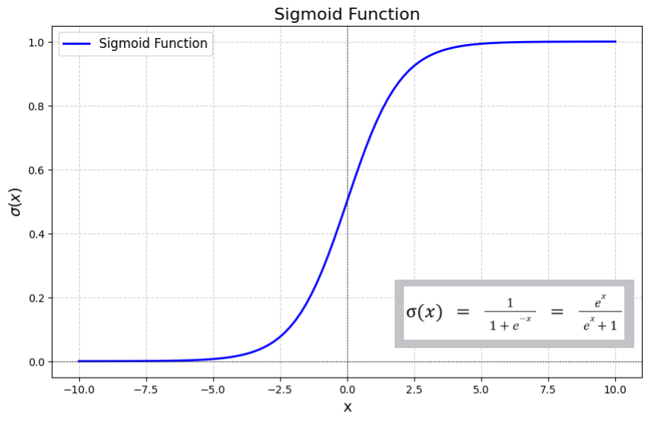
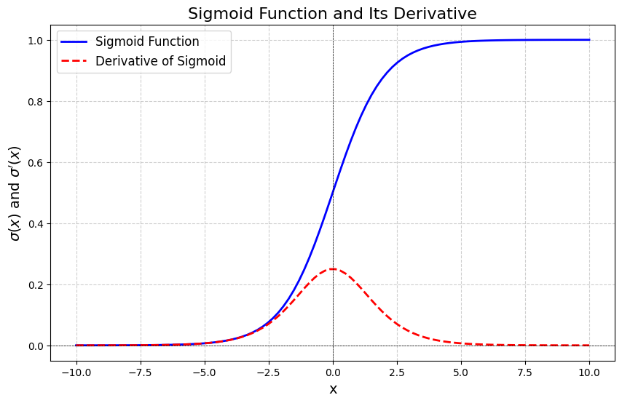
Sigmoid Activation Function
Sigmoid is a mathematical function that maps any real-valued number into a value between 0 and 1. Its characteristic "S"-shaped curve makes it particularly useful in scenarios where we need to convert outputs into probabilities. This function is often called the logistic function.

Slide 27
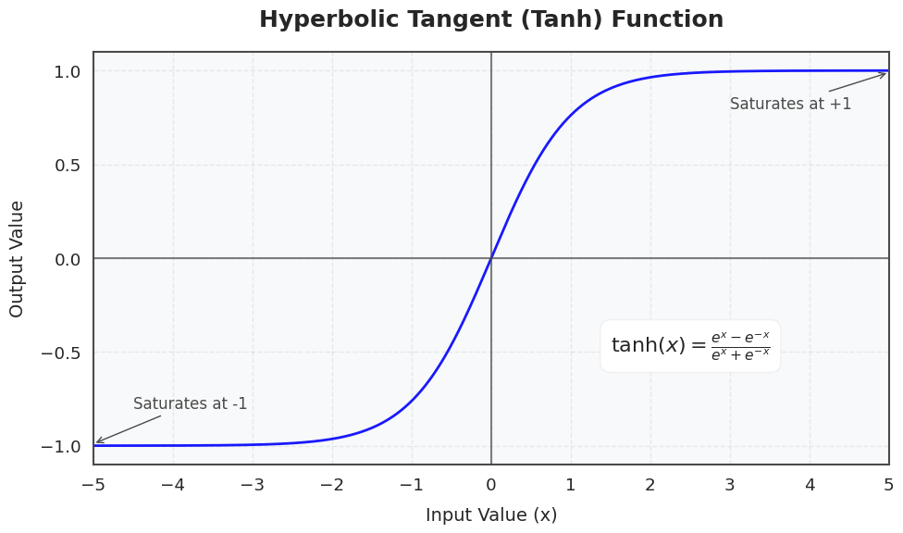
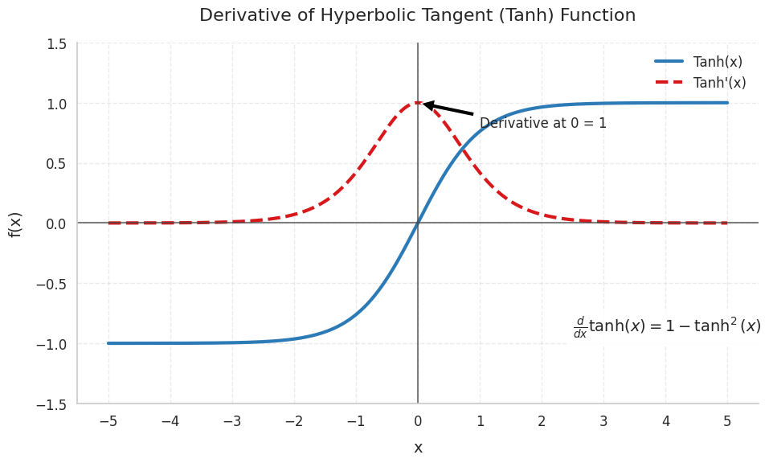
Tanh Activation Function
Tanh (hyperbolic tangent) is a type of activation function that transforms its input into a value between -1 and 1.

Slide 28
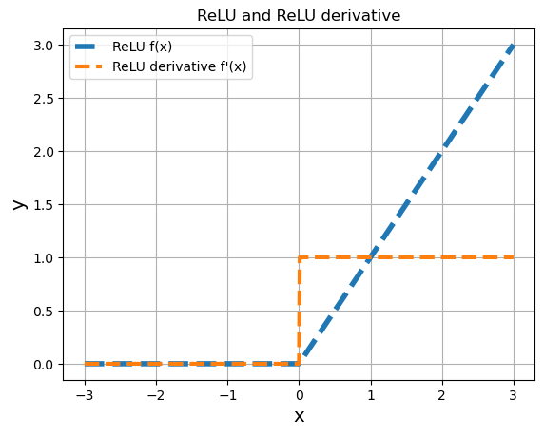
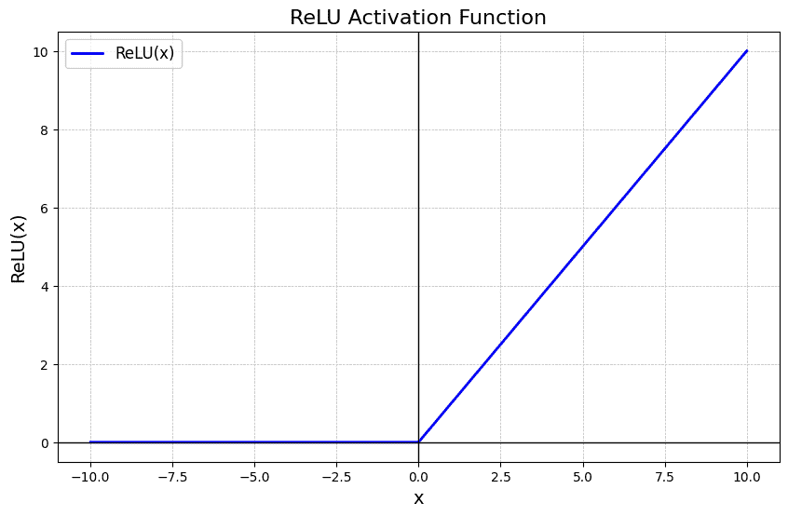
ReLU Activation Function
ReLU (Rectified Linear Unit) is a widely used activation function in deep learning that outputs the input directly if it is positive and returns zero otherwise. Its simplicity and efficiency make it a default choice in many neural network architectures, helping models learn complex patterns while reducing issues like the vanishing gradient problem.

Slide 29
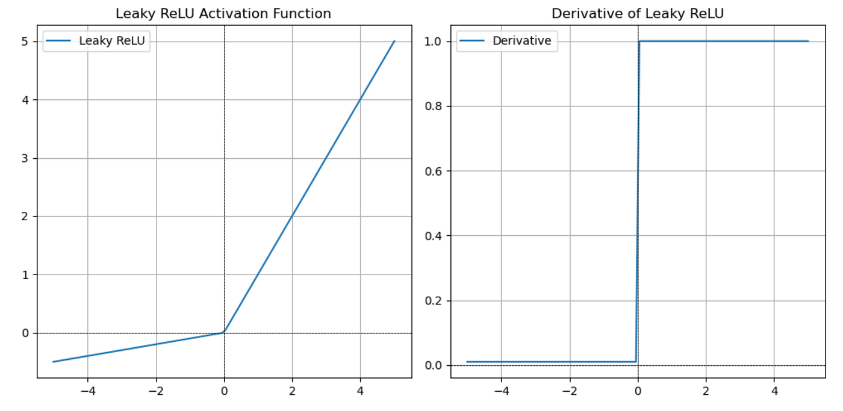
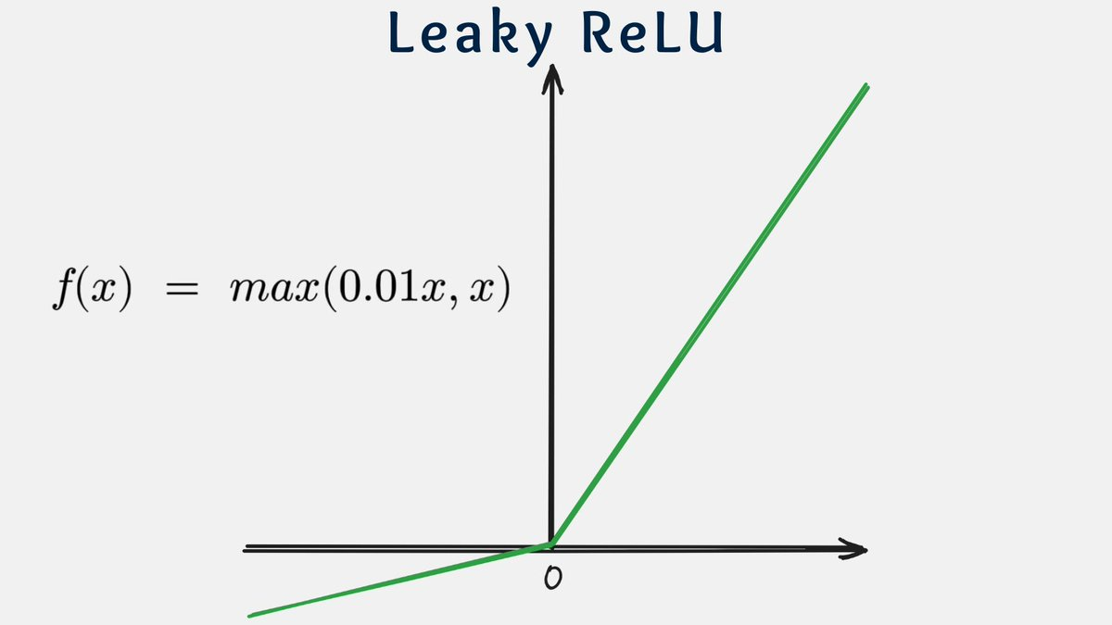
Leaky ReLU Activation Function
Leaky ReLU is a modified version of ReLU designed to fix the problem of dead neurons. Instead of returning zero for negative inputs it allows a small, non-zero value. It introduces a slight modification to the standard ReLU by assigning a small, fixed slope to the negative part of the input.

Slide 30
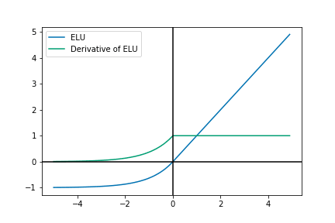
ELU Activation Function
ELU (Exponential Linear Unit) is a activation function used in neural networks which is an advanced version of widely used relu activation function. But before understanding ELU it's important to recognize the shortcomings of ReLU and Leaky ReLU activation function.

Slide 31
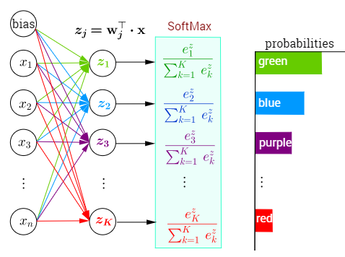
Softmax Activation Function
Softmax Activation Function transforms a vector of numbers into a probability distribution, where each value represents the likelihood of a particular class. It is especially important for multi-class classification problems.

Slide 32
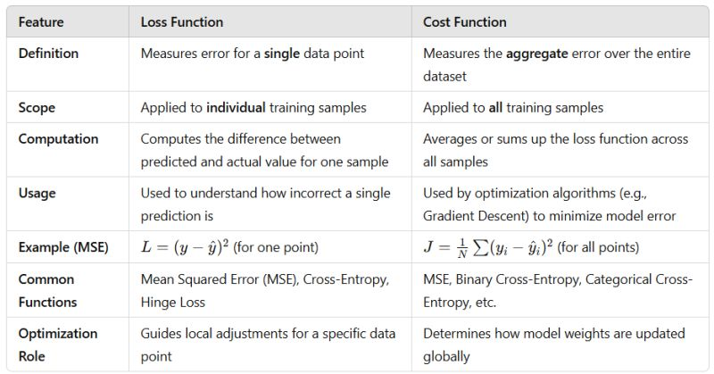
Loss Function vs Cost Function

Slide 33
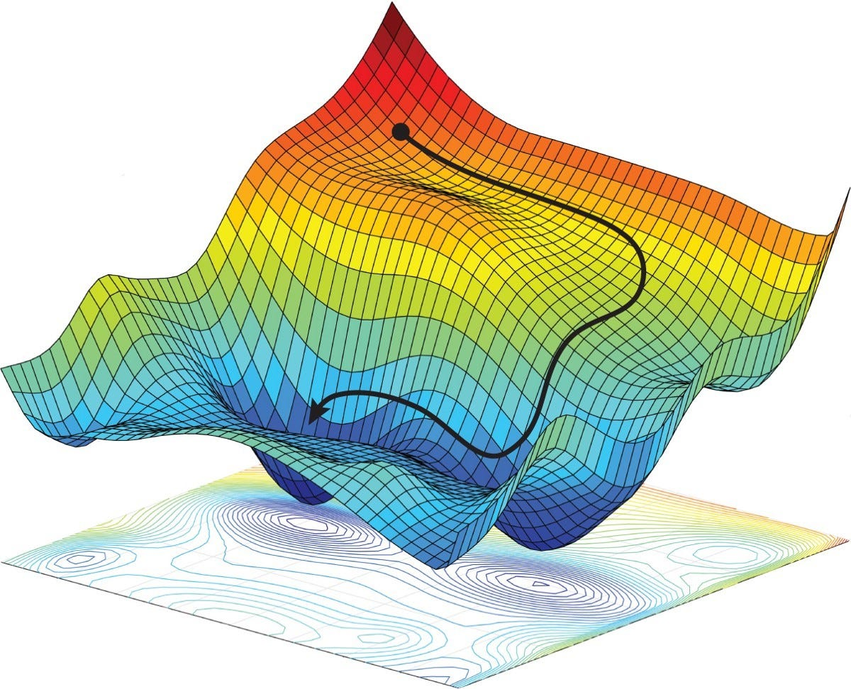
Optimizers

Slide 34
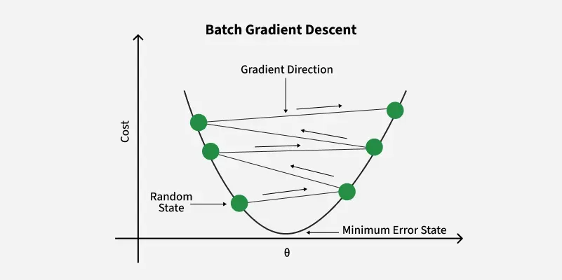
Gradient Descent
Gradient descent is a optimization algorithm in machine learning used to minimize functions by iteratively moving towards the minimum. It's important as fine-tuning parameters helps us to reduce prediction errors. In this article we are going to explore different variants of gradient descent algorithms.

Slide 35
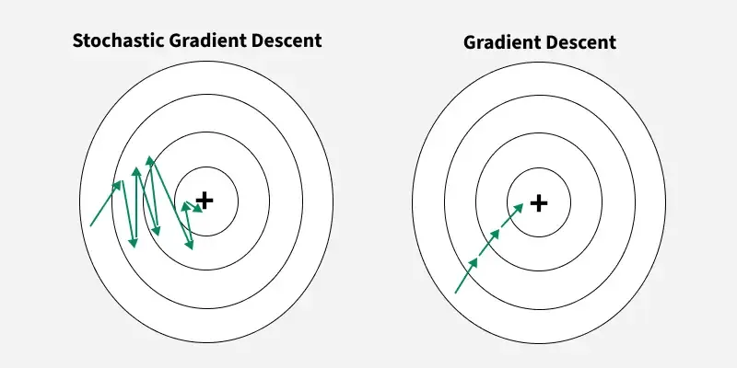
Stochastic Gradient Descent (SGD)
Stochastic Gradient Descent is an optimization algorithm used in machine learning, especially for large datasets, that updates model parameters efficiently using small batches or single samples.

Slide 36
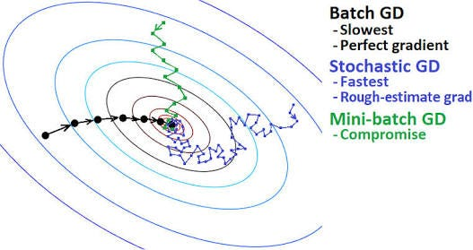
Mini Batch Stochastic Gradient Descent (SGD)
Mini-Batch Stochastic Gradient Descent (SGD) is an optimization algorithm that splits the training data into small groups—called mini-batches (typically sized 32, 64, or 128)—to compute loss gradients and update model parameters. It combines the computational efficiency of standard batch gradient descent with the speed and adaptability of pure stochastic gradient descent.

Slide 37
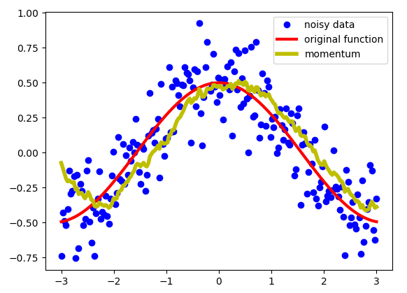
Stochastic Gradient Descent (SGD) Momentum
Momentum-Based Gradient Descent is an enhancement of standard gradient descent algorithm that aims to accelerate convergence particularly in the presence of high curvature, small but consistent gradients or noisy gradients. It introduces a velocity term that accumulates the gradient of the loss function over time thereby smoothing the path taken by the parameters.

Slide 38
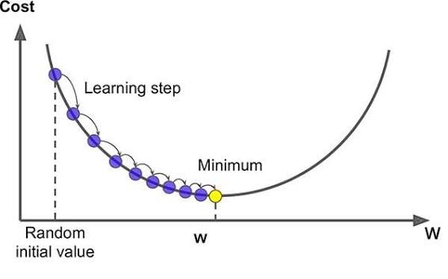
Adaptive Gradient Descent (Adagrad)
Adagrad is an optimization method that adapts the learning rate for each parameter based on past gradients, improving learning for features with different frequencies.

Slide 39
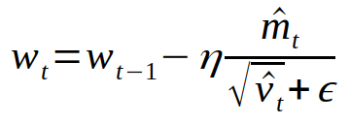
Adam (Adaptive Moment Estimation) optimizer
Adam (Adaptive Moment Estimation) optimizer combines the advantages of Momentum and RMSprop techniques to adjust learning rates during training. It works well with large datasets and complex models because it uses memory efficiently and adapts the learning rate for each parameter automatically.

Slide 40
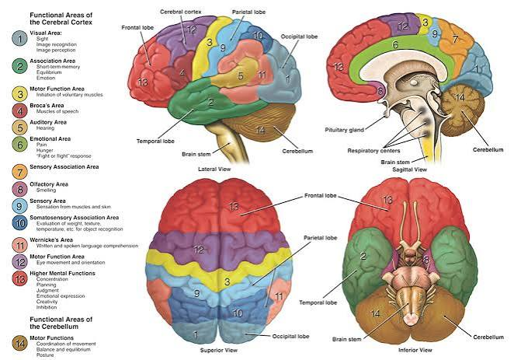
Convolutional Neural Network (CNN) in Deep Learning
Convolutional Neural Networks (CNNs) are deep learning models designed to process data with a grid-like topology such as images. They are the foundation for most modern computer vision applications to detect features within visual data.

Slide 41
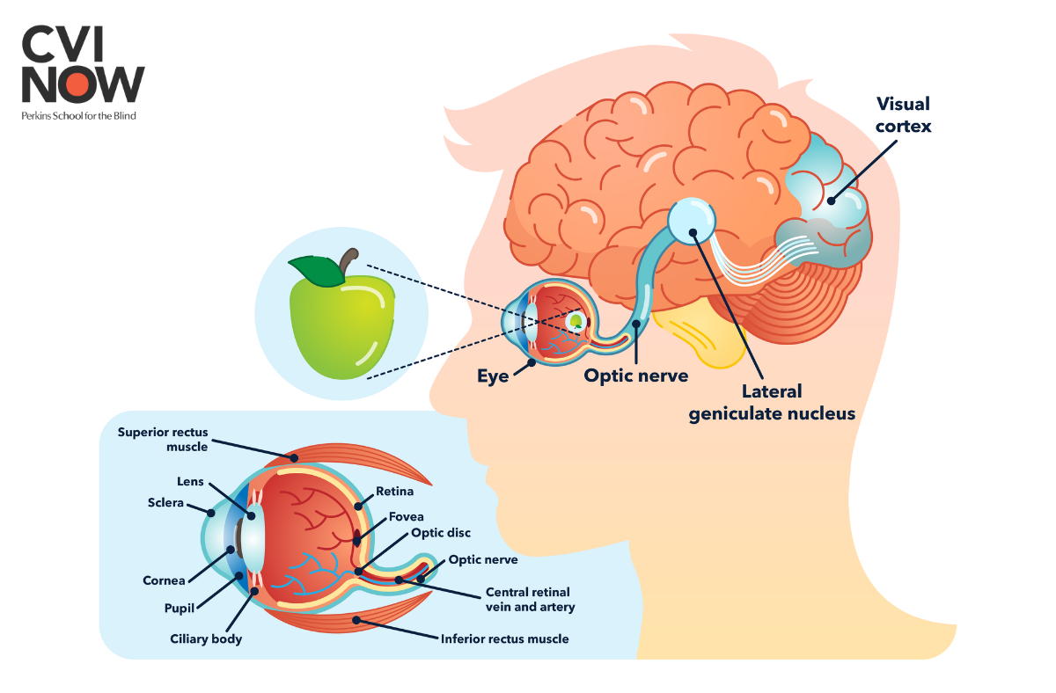
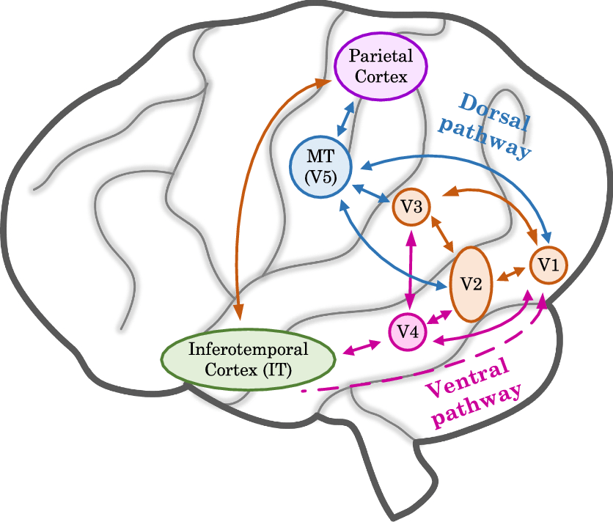
Convolutional Neural Network (CNN) in Deep Learning
The visual cortex is the part of the cerebral cortex at the back of the brain inside the occipital lobe. It receives, tracks, and turns light signals from the eyes into what we see.

Slide 42
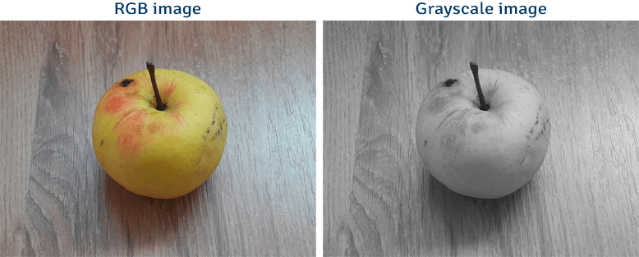
Differentiate Between Grayscale and RGB Images
There are two primary digital picture formats that are used for distinct purposes: grayscale and RGB (red, green, or blue). Images in grayscale consist of black and white pixels, each of which has a grey color intensity. However, RGB images can exhibit a wide variety of hues since they are made up of three color channels: red, green, and blue.

Slide 43
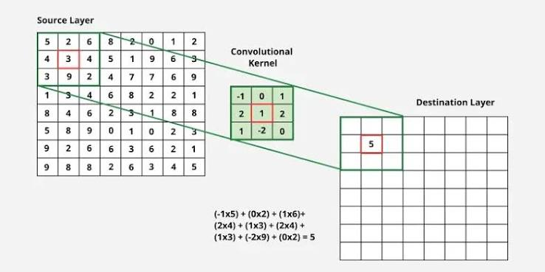
Kernels (Filters) in convolutional neural network
Convolutional Neural Networks (CNNs) are neural networks used for processing image data. Kernels also known as filters are an important part of CNNs which helps them to extract important features from images such as edges, textures and patterns. In this article, we will see more about kernels.

Slide 44
Kernels (Filters) in convolutional neural network
Convolutional Neural Networks (CNNs) are neural networks used for processing image data. Kernels also known as filters are an important part of CNNs which helps them to extract important features from images such as edges, textures and patterns. In this article, we will see more about kernels.

Slide 45
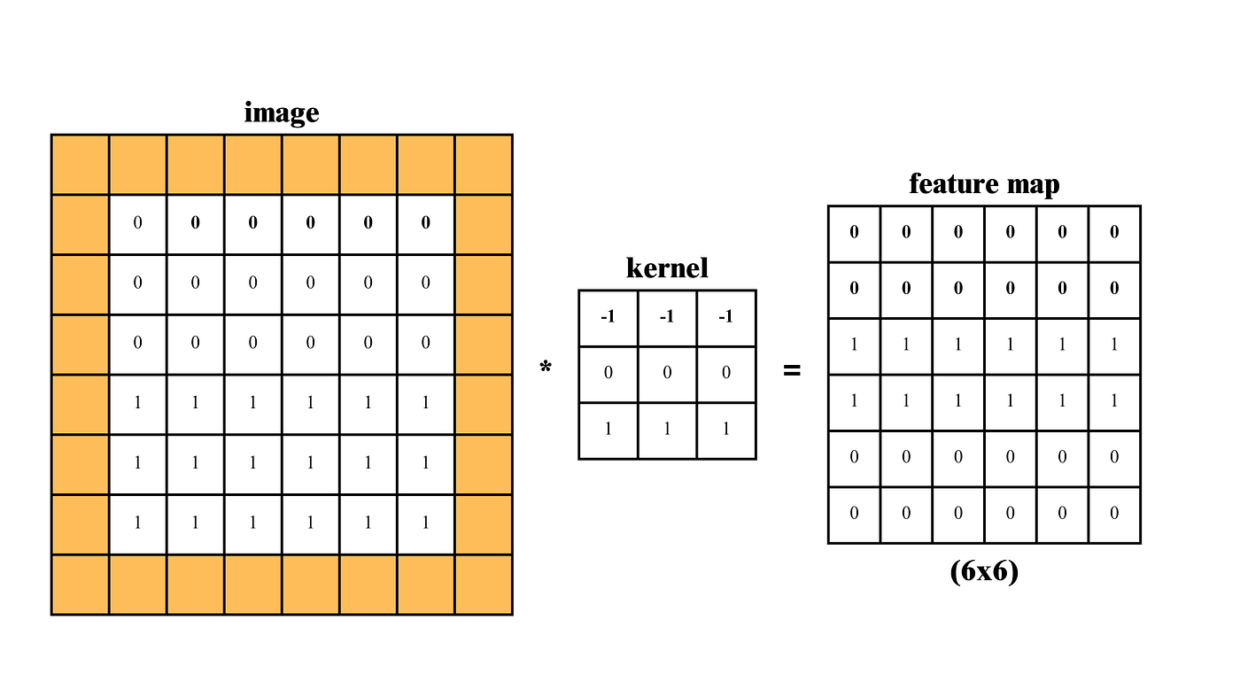
Padding in CNNs
Padding is a technique used to preserve the spatial dimensions of the input image after convolution operations on a feature map. Padding involves adding extra pixels around the border of the input feature map before convolution.

Slide 46
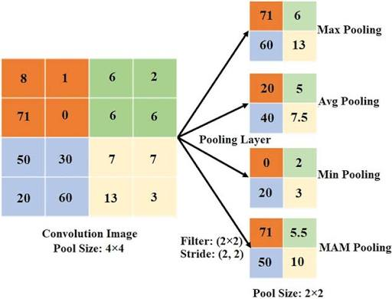
Pooling Layer in CNN
A pooling layer is used to reduce the spatial dimensions (width and height) of feature maps while keeping the most important information.

Slide 47
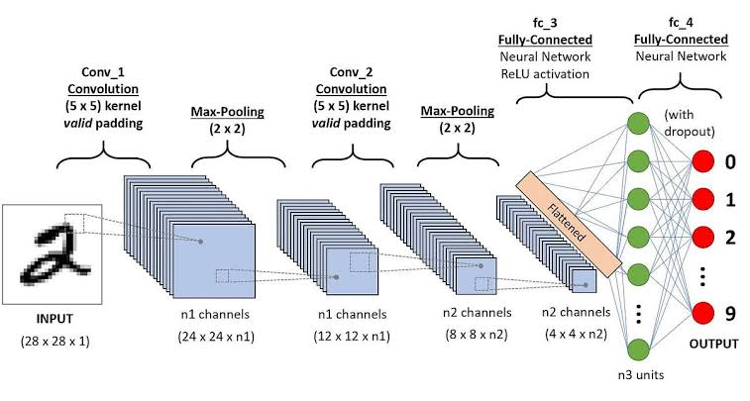

Flattering and Fuly connected layers

Slide 48
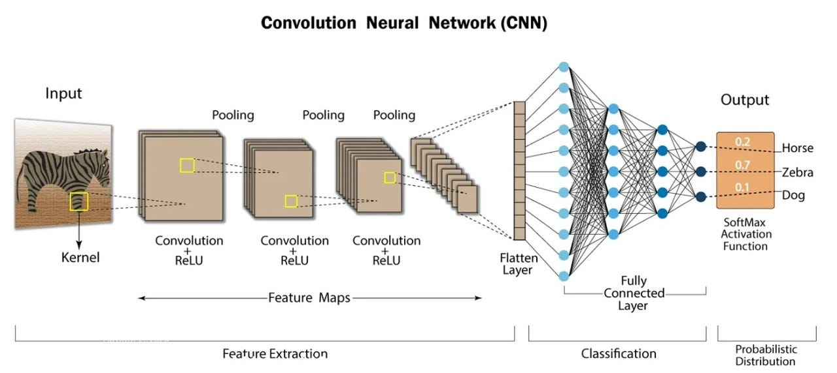
CNN with RGB

Slide 49
What is Sequential Data in Data Science?
Sequential data is a type of data where the order of observations matters. Each data point is part of a sequence, and the sequence’s integrity is crucial for analysis. Examples include sequences of words in a sentence, sequences of actions in a process, or sequences of genes in DNA.
Analyzing sequential data is vital for uncovering underlying patterns, dependencies, and structures in various fields. It helps in tasks such as natural language processing, bioinformatics, and user behavior analysis, enabling better predictions, classifications, and understanding of sequential patterns.

Slide 50
Types of Sequential Data
1. Time Series Data
Time series data consists of observations recorded at specific time intervals. This type of data is crucial for tracking changes over time and is widely used in fields such as finance, meteorology, and economics. Examples include stock prices, weather data, and sales figures.
2. Text Data
Text data represents sequences of words, characters, or tokens. It is fundamental to natural language processing (NLP) tasks such as text classification, sentiment analysis, and machine translation. Examples include sentences, paragraphs, and entire documents.
3. Genetic Data
Genetic data comprises sequences of nucleotides (DNA) or amino acids (proteins). It is essential for bioinformatics and genomic studies, enabling researchers to understand genetic variations, evolutionary relationships, and functions of genes and proteins. Examples include DNA sequences, RNA sequences, and protein sequences.

Slide 51
Types of Sequential Data
1. Time Series Data
Time series data consists of observations recorded at specific time intervals. This type of data is crucial for tracking changes over time and is widely used in fields such as finance, meteorology, and economics. Examples include stock prices, weather data, and sales figures.
2. Text Data
Text data represents sequences of words, characters, or tokens. It is fundamental to natural language processing (NLP) tasks such as text classification, sentiment analysis, and machine translation. Examples include sentences, paragraphs, and entire documents.
3. Genetic Data
Genetic data comprises sequences of nucleotides (DNA) or amino acids (proteins). It is essential for bioinformatics and genomic studies, enabling researchers to understand genetic variations, evolutionary relationships, and functions of genes and proteins. Examples include DNA sequences, RNA sequences, and protein sequences.

Slide 52
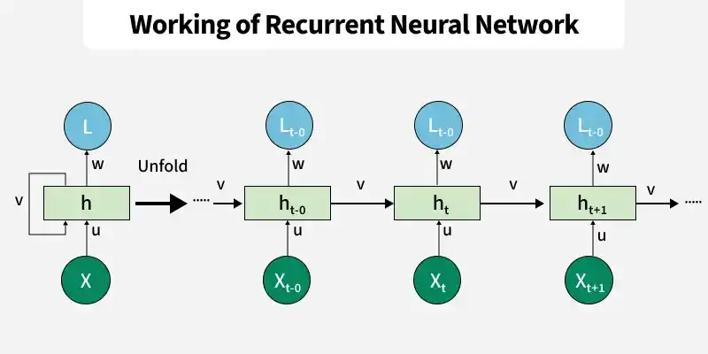
Simple Recurrent Neural Network
Recurrent Neural Networks (RNNs) are a class of neural networks designed to process sequential data by retaining information from previous steps. They are especially effective for tasks where context and order matter.

Slide 53
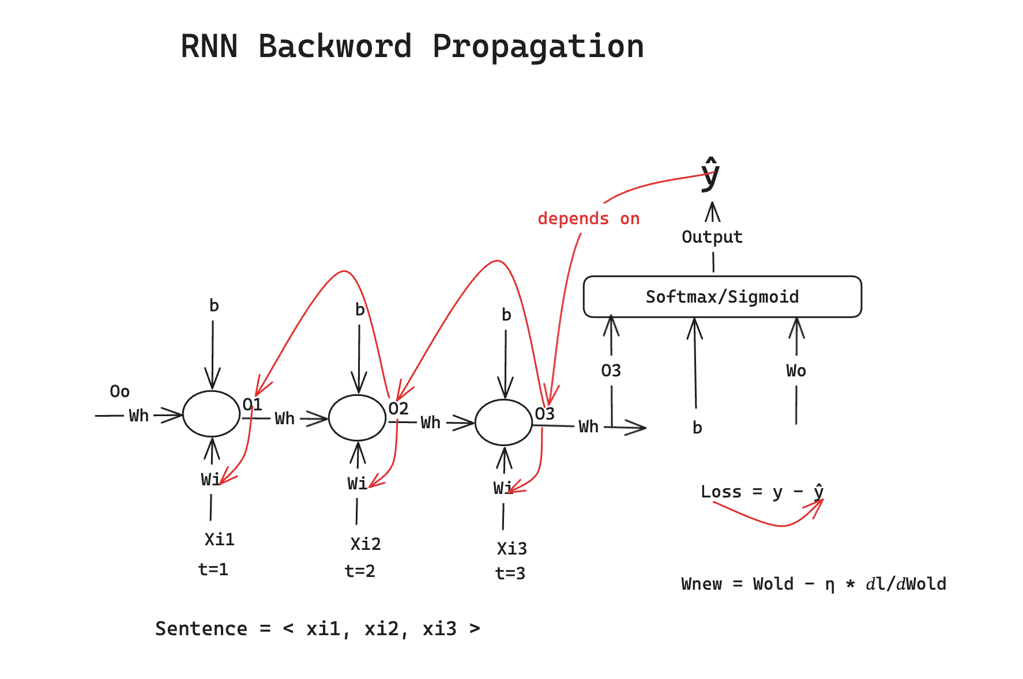
Forward and Back Propogation in RNN
In a Recurrent Neural Network (RNN), forward propagation passes sequential data through time steps to compute hidden states and outputs, while backpropagation through time (BPTT) calculates gradients by unfolding the network in reverse to update shared parameters.

Slide 54
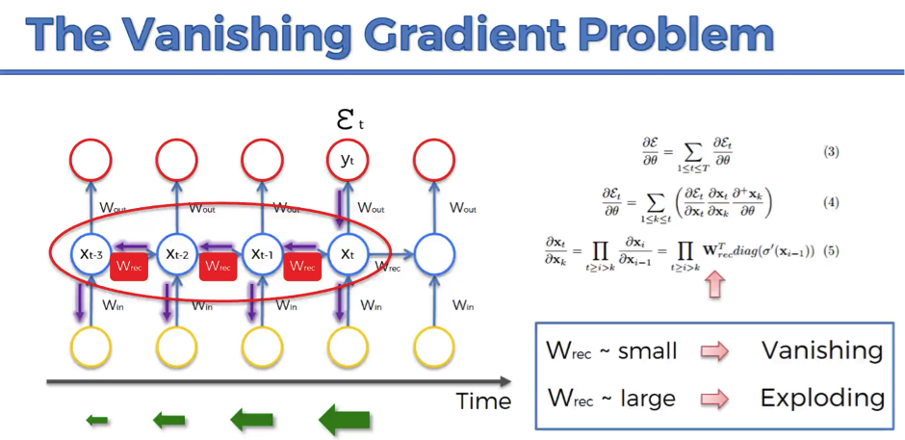
Vanishing Gradient in RNN
The vanishing gradient problem in Recurrent Neural Networks (RNNs) occurs when error gradients shrink exponentially toward zero during backpropagation through time. This happens due to repeated multiplication of small recurrent weights and activation function derivatives across many time steps, preventing the network from learning long-term dependencies

Slide 55

The Problem of Long-Term Dependencies
One of the appeals of RNNs is the idea that they might be able to connect previous information to the present task, such as using previous video frames might inform the understanding of the present frame. If RNNs could do this, they’d be extremely useful. But can they? It depends.

Slide 56

LSTM Networks
Long Short Term Memory networks – usually just called “LSTMs” – are a special kind of RNN, capable of learning long-term dependencies. They were introduced by Hochreiter & Schmidhuber (1997), and were refined and popularized by many people in following work.¹ They work tremendously well on a large variety of problems, and are now widely used. LSTMs are explicitly designed to avoid the long-term dependency problem. Remembering information for long periods of time is practically their default behavior, not something they struggle to learn!
The repeating module in an LSTM contains four interacting layers.

Slide 57


The Core Idea Behind LSTMs
The key to LSTMs is the cell state, the horizontal line running through the top of the diagram.
The cell state is kind of like a conveyor belt. It runs straight down the entire chain, with only some minor linear interactions. It’s very easy for information to just flow along it unchanged.

Slide 58

Step-by-Step LSTM Walk Through: Forget Gate
The first step in our LSTM is to decide what information we’re going to throw away from the cell state. This decision is made by a sigmoid layer called the “forget gate layer.” It looks at ht−1 and xt, and outputs a number between 0 and 1 for each number in the cell state Ct−1.
Imagine an AI reading this customer review: "I initially thought this phone was terrible because the battery died in two hours, but after updating the software, it works flawlessly and is amazing."
The Shift in Context
Initial State: The network reads "terrible" and "battery died." It stores a strongly negative sentiment in its memory cell.
The Turn: The word "but" signals a major shift in the story.
Why We Forget: If the network keeps the strong negative context, it will misinterpret the final rating. It needs to clear out the old complaint because the user's situation changed.
The Action: The forget gate encounters "but after updating..." and drops the old "terrible battery" context (outputs close to 0). At the same time, the input gate adds the new, positive context ("flawlessly", "amazing").

Slide 59

Input Gate and Candidate Memory
The second step of an LSTM cell updates the state with new data. A sigmoid input gate picks which values to change. A tanh layer makes a vector of new candidate values Ct Both parts work together to shape the future memory.

Slide 60

Input Gate and Candidate Memory
an LSTM cell updates its memory state Ct- 1 to Ct by forgetting old information using the forget gate F(t) and adding new scaled information. It completes the core memory update mechanism of a recurrent neural network.

Slide 61

Output Gate
The final step of an LSTM cell determines its output through a two-step filtering process:
Sigmoid Gate: Selects which parts of the cell state to output.
Tanh Transformation & Filtering: Pushes the cell state values between -1 and 1, then multiplies them by the sigmoid output so only the chosen features are passed through.

Slide 62

Variants on Long Short Term Memory
While standard LSTMs follow a common structure, minor variations frequently appear across academic research. A notable example is the "peephole connections" variant introduced by Gers & Schmidhuber (2000), which modifies the traditional architecture by allowing the internal gate layers to directly observe the cell state when making decisions.

Slide 63

Variants on Long Short Term Memory
Another variation is to use coupled forget and input gates. Instead of separately deciding what to forget and what we should add new information to, we make those decisions together. We only forget when we’re going to input something in its place. We only input new values to the state when we forget something older.

Slide 64

Gated Recurrent Unit GRU
The Gated Recurrent Unit (GRU), introduced by Cho et al. (2014), simplifies the standard LSTM architecture by merging its core components:
Unified Update Gate: Combines the separate forget and input gates into a single gate that simultaneously determines what to retain and what to update.
Merged State: Merges the cell state (C_t) and hidden state (h_t) into a single hidden state representation.
Efficiency: Eliminates internal parameters compared to the LSTM, making it computationally lighter and widely popular for sequence modeling.

